Slide 1
LAN Hardware
Prepared By: Er. Amit kr Tewari
Associate Professor
CS Dept.
ACEIT, Jaipur

Slide 2
LAN Hardware
All LANs are a combination of hardware and software.
The primary hardware devices are the computers themselves and the cables and connectors that link them.
Additional pieces of hardware unique to networks include network interface cards, repeaters, hubs and concentrators, bridges, routers, gateways, and many other special interfacing devices

Slide 3
1. Cables
Most LANs use some type of copper wire cable to carry data from one computer to another via baseband transmission.
The three basic cable types used in LANs are coaxial cable, twisted-pair, and fiber-optic cable.
Most local-area networks started out using coaxial cable, but today twisted-pair cable dominates.
Fiber- optic cable is used in higher-speed, secure networks, which are not as widespread.

Slide 4
Coaxial Cable
Coaxial cable is a superior medium because its extremely wide bandwidth permits very high-speed bit rates.
Although loss is generally high, attenuation is usually offset by using repeaters that boost the signal level and regenerate the signal wave shape.
The major benefit of coaxial cable is that it is completely shielded, so that external noise has little or no effect on it.

Slide 5
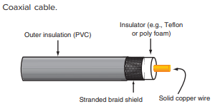
Coaxial Cable

Slide 6
Twisted-Pair Cable
Twisted-pair cable is the most widely used network cable.
Twisted-pair, as the name implies, is two insulated copper wires twisted together loosely to form a cable.
Telephone companies use twisted-pair cable to connect individual telephones to the central office.

Slide 7
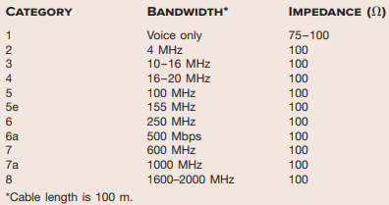

Slide 8
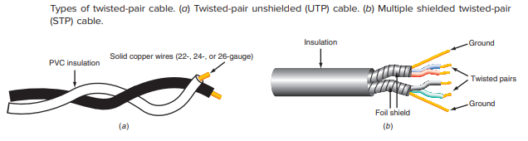
Twisted-Pair Cable

Slide 9
Fiber-Optic Cable
Fiber-optic cable is a non-conducting cable consisting of a glass or plastic center cable surrounded by a plastic cladding encased in a plastic outer Jacket.

Slide 10
2. Connectors
All cables used in networks have special terminating connectors.
Connectors provide a fast and easy way to connect and disconnect the equipment from the cabling and maintain the characteristics of the cable through the connection.

Slide 11
Coaxial Cable Connectors
Coaxial cables are no longer used in networks.
However, if you do find them, they use two types of connectors, N connectors and BNC connectors.

Slide 12
Twisted-Pair Connectors
Most telephones attach to an outlet by way of an RJ-11 connector or modular plug.
RJ-11 connectors are used to connect PC modems to the phone line but are not used in LAN connections.
A larger modular connector known as the RJ-45 connector is widely used in terminating twisted pairs.

Slide 13
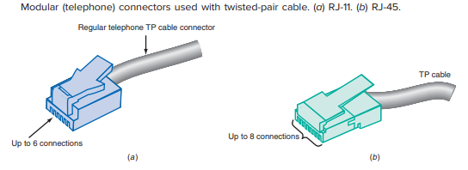
Twisted-Pair Connectors

Slide 14
Fiber-Optic Connectors
A wide range of connectors are available to terminate fiber-optic cables.
Like electrical connectors, these are designed to provide a fast and easy way to attach or remove cables.

Slide 15
3. Network Interface Controller
A network interface controller (NIC) provides the I/O interface between each node on a network and the network wiring.
NIC is one or more ICs that are integrated into the motherboard of the PC and provide connectors at the rear of the computer for attaching the cable connectors.
The NIC is the key hardware component in any LAN. It completely defi nes the protocols and performance characteristics of the LAN.

Slide 16
4. Repeaters
When signals from a NIC must travel a long distance over coaxial cables or twisted-pair cables, the binary signal is greatly attenuated by the resistance of the wires and distorted by the capacitance of the cable.
As a result, the signal can be too distorted and noisy to be received reliably.
A common solution to this problem is to use one or more repeaters along the way.
A repeater is an electronic circuit that takes a partially degraded signal, boosts its level, shapes it up, and sends it on its way.
Over long transmission distances, several repeaters may be required.

Slide 17

Concept of Repeaters

Slide 18
5. Hubs
A hub is a LAN accessory that facilitates the interconnections of the cables to the nodes.
It is a central connecting box designed to receive the cable inputs from the various PC nodes and to connect them to the server.
In most cases, hub wiring physically resembles a star because all the cabling comes into a central point.

Slide 19
Hubs (Contd…)
Hubs are usually active devices containing repeaters.
Hubs amplify and reshape the signal and transmit it to all connection parts.
Hubs are available with 8, 12, 16, 24, 32, and 48 ports. All signals received at the hub are repeated to all nodes connected to the hub.

Slide 20
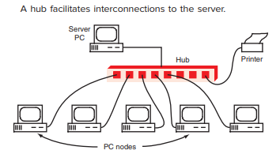
Hubs

Slide 21
6. Bridges
A bridge is a network device that is connected as a node on the network and performs bidirectional communication between two LANs.
A bridge can also be used when one LAN becomes too big.
Most LANs are designed for a maximum upper limit of nodes.
One way to deal with this problem is to break a large LAN into two or more smaller LANs.
A bridge is generally designed to interconnect two LANs with the same protocol, e.g., two Ethernet networks.
However, there are bridges that are able to accomplish protocol conversion so that two LANs with different protocols can converse.

Slide 22
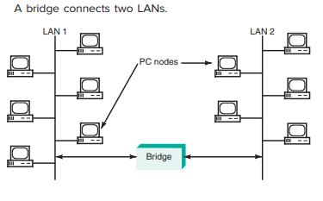
Bridges

Slide 23
7. Switches
A switch is a hub like device used to connect individual PC nodes to the network wiring. Unlike a hub, a switch provides a means to connect or disconnect a PC from the network wiring.
Switches have largely replaced hubs in most large LANs because switches greatly expand the number of possible nodes and improve performance.
Ethernet switches have become the key component in most LANs.
They implement the interconnection between servers, PCs, and other nodes but also speed up the entire network by reducing the number of collisions and allowing one PC to speak directly to another

Slide 24
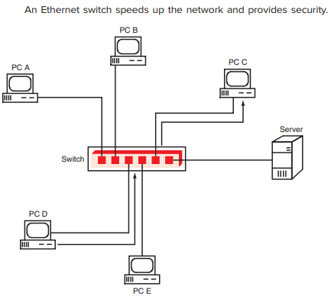
Switches

Slide 25
8. Routers
Like bridges, routers are designed to connect two networks.
The main difference between bridges and routers is that routers are intelligent devices that have decision-making and switching capabilities.
The basic function of a router is to expedite traffic flow on both networks and maintain maximum performance.

Slide 26
Routers
When many users access a network at the same time, conflicts occur and speed performance is degraded.
Routers are designed to recognize traffic buildup and provide automatic switching to reroute transmissions in a different direction, if possible.
If transmission is blocked in one direction, the router can switch transmission through other nodes or other paths in the network.

Slide 27
9. Gateways
A gateway is another internetwork device that acts as an interface between two LANs or between a LAN and a larger computer system.
The primary benefit of a gateway is that it can connect networks with incompatible protocols and configurations.
The gateway acts as a two-way translator that allows systems of different types to communicate.
As the number of companies that provide hardware increases, the functions of each device vary and devices labeled as routers may perform the functions of the switch, router, and gateway.

Slide 28
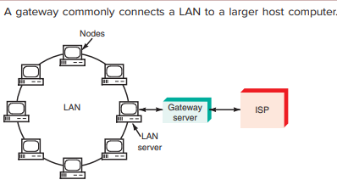
Gateways

Slide 29
10. Modems
modems are interfaces between PCs and communications systems, such as the telephone or cable TV networks.
They convert the binary signals of the computer to analog signals compatible with the telephone or cable TV system and, at the other end, convert the analog signals back to digital signals.
Modems are widely used in home networking to connect to an Internet service provider (ISP), which provides services such as Internet access and e-mail.

Slide 30
11. Wireless LANs
One of the most complex and expensive parts of any LAN is the cabling.
One way to avoid the expense and headache of running and maintaining LAN cabling is to use wireless LANs, which communicate via radio.

